Slide 1
Understanding of Complaints and Praises of “Woohoo Gift card” – Google Reviews.
REVA Academy for Corporate Excellence (RACE)
By HARSHA GV,
RACE Program Office
May 29th 2021
race.reva.edu.in

Slide 2

Brief Introduction about me
Name :- Harsha GV
Industry :- Market Research, Retail , CPG & Gift card.
Years of experience :- 12 Years
Current Designation :- Project Manager Operations
Currently Working :- Pine labs Pvt Ltd.
Previous worked :- Unilever (HUL), Infosys (P&G client), WNS Global Services Pvt Ltd (P&G, Coca Cola & Sony music clients) & Fractal analytics (P&G client) ,

Slide 3
Abstract –Quick Review
Name of the Project
Background Information
Statement of the Problem
Detailed Scope of work
Proposed Solution
References
Future scope of study
Business Understanding
Data preparation
Analysis
SWOT
Recommendation

Slide 4

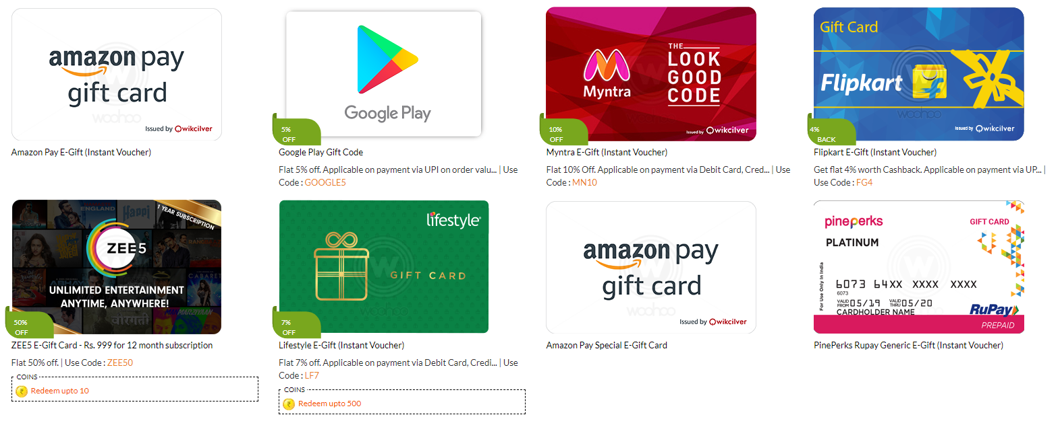
Understanding of Complaints and Praises of “Woohoo Gift card” – Google Reviews. (Future Facebook and Twitter)
Name of the Project
Project
Type of data analytics
Text Analytics
Source
Google reviews – Current rating 4.1

Slide 5
Background Information
Back Ground Information
Gift cards, also known as gift certificates, gift vouchers, or gift tokens, are generally issued by a retailer or bank. In addition, gift cards are used as a developmental strategy for promoting businesses, attract new customers, increase brand awareness, reduce fraud, and improve business sales. Moreover, a gift card can be utilized as an alternative source for money at a particular store or business store for purchases related to goods or services.
Company “Qwikcilver solutions pvt Ltd” brand Woohoo gift card has more than 90 -95% Market share in India, Indian market is expected to grow to 9.34Billion by 2024 . and Global industry is expected to grow by 2076 Billion by 2027.
In order to improve the customer needs & experience, we need to understand the customer by analysing the customer reviews to serve them better.

Slide 6
Statement of the Problem
Gift card industry is available in India for more than a decade. But the product is yet to be completely accepted by customers. In order to serve the customers better and understand the concern areas. We want to analyse the customer complaints and Praises using the Google reviews given by customers for the past 5 years.

Slide 7
Proposed Solution
1. Use web scrapping of woohoo brand Google reviews to collect customer reviews/ comments.
2. Leverage on Text analytics methodology and build an understanding on complaints and praises to derive insights.

Slide 8
Detailed Scope of work
Going through different research paper on analysing the customer reviews -text and doing analysis.
Collect data via web scrapping . Acquire the data from Google reviews comments, rating.
Follow the below method to derive insights.
We have collected 2782 google reviews for the Woohoo Gift card. We will be doing following analysis
Data understanding on the self evaluation sentiment positive and negative
NRC Lexicon Sentiment analysis
Vader Lexicon Sentiment analysis
Comparison of both the Sentiments
Naive Bayesian - Bag of Words (BoW) using Count Vectorizer
Naive Bayesian - Bag of Words (BoW) using TF-IDF Vectorizer
Comparing the models and selecting the best model
Sentence Length Analysis
Categorise the Negative only , complaints, Positive only , Praise.
Comparison of the Categories and performance over current vs the past
As per business understanding creating the product features - buckets.
Analysis by Comparing the Product performance with Categories and also compare over the past performance..
Recommendation

Slide 9
Future scope of study
Future scope of study which is not part of the Current project.
Negation handling.
N-grams (unigram, bigram, trigrams).
Noun and Adjective Usage.
Paste tense analysis
Intensifier Usage
Taking reviews and comments from other social media platforms Facebook and twitter.

Slide 10
Business Understanding
Gift Card industry complete process... to understand the business explained below
Many of Retail companies want to promote their brand and increase sales, in order to do this, they contact the gift card company.
Gift card once sold to the Customers. Customers will be purchasing the final product and use the gift card in online purchases and offline stores.
In the Gift card, there are 2 types Retail Gift cards and promotional.
Retail Gift: This is a Gift card that the customers purchase by buying the complete price. Example 1000 Rs gift card customer can purchase any product worth 1000 Rs.
Promotional: Giving the promotional gift card which has an offer through we can the product at a discounted price, in some cases the discount is allowed based on the Fixed Benchmark price. Example: 200Rs promotional Gift card can be used on the purchase of 2000 Rs worth of the product.
The company licensed from the RBI are authorised to issue Gift cards.
Similar to any credit/debit card every merchant Brand has unique numbers are provided so that the Gift card functions as per the client requirements and T&C.
In the Gift card, we have Activation, Redemption, refund, and validity extension of the gift card.
Customers use Web portal / App to log in to purchase the Retail Gift card / promotional Gift card
Once purchased, It can be used sent to yourself, friends, and others through SMS, Mail.
Customers who post validation and Login to the portal can claim the Gift card.

Slide 11
Business Understanding
11. In order to Redeem/use the gift card, the Gift card PIN needs to be used to authorizing the Merchant to use the Gift card money to purchase the product.
12. Every gift card has a validity duration, post this it will be expired and cannot be used.
13. In case the Brand agrees or customer requests (approved by the brand) the Gift card validity will be extended.
14. The Terms and Conditions of each gift card are based on the Brand requirement.
15. The customers like the Gift card because of the following reasons.
They have access to a wide variety of brands to choose from.
It gives them good discounts, promotional offers.
Gift people with Ecard / physical gift card instead of giving physical cash.
Based on customer convenience the card can be used online and offline stores.
We can store all the Gift cards in one place.
Having multiple payment gateways, we are able to purchase the product.
Faster processing and delivery of service using the latest technology is the key to success.
Easy to use across the age group attracts the customers.

Slide 12
Business Understanding
As per business understanding we have identified the product features. This would help us to determine if the company is providing better services to the customers.
We have gone through every 2872 reviews and marked them based on the
Feedback provided by the customers on how they Perceive towards the brand Good, not good on the product features
# | Product features |  | Details - Based on which we have grouped.
1 | Customer Support not good |  | Customer Support / Chat Support Service/ Awaiting Response/Help me issues
2 | Delivery of service not good |  | Delivery Service Issues / Receving, Activation, Redeem, Refund, OTP
3 | App/ Web Issues |  | Web App Issues / Login / UI / How to use/ App Issues
4 | Payment Issues |  | Payment Issues / Add other Payment Brands
5 | Promotion/offers Issues |  | Promotional offer Issues / less offers / Cashbacks / Add brands
6 | Validity Issues |  | Validity Issues
7 | Not Trusting the Brand |  | Un trustable / Frauds/Waste /Cheat / Fake/ not good /Scam
8 | Speed of delivery good |  | Faster buying process
9 | App/ Web good |  | Web App Good/ Nice /Great / Awesome
10 | Promotion/offers good |  | Best Offers Deals / Discounts
11 | Price is good |  | Price is good / Save Money
12 | Customer Support good |  | Customer Service is good
13 | Easy to use |  | Easy to Use
14 | Multiple Brands to choose good |  | Buy Wide range of brands
15 | Delivery of service good |  | Delivery service is Good
16 | Payment Good |  | Easy Payment / Multiple Payment modes

Slide 13
Data preparation
We have extracted the data from the Goole review for the Woohoo Gift card from the google app store.
Extracting the data collecting the review given by customers, the year of review and rating
Going through the review, we have done the self-evaluation and code the positive and negative reviews.
Load the data into python and doing the preliminary analysis
We have 2782 Records
There are Zero Missing values in the data
In the review’s sentiment (we have self-coded the sentiment) we have 58.7% Positive and 41.3% Negative

Slide 14
Data preparation
5. Cleaning the data by the below process.
Removing special characters, punctuation, square bracket, numbers, double spacing.
Convert all the upper case to lower case.
Tokenization: Tokenization is the act of breaking up a sequence of strings into pieces such as words, keywords, phrases, symbols and other elements called tokens. We have Created the tokens in a separate column in the data frame.
Stop Words removal: - A stop word is a commonly used word (such as “the”, “a”, “an”, “in”) that a search engine has been programmed to ignore, both when indexing entries for searching and when retrieving them as the result of a search query. Post tokenization we have removed the stop words.
Stemming and Lemmatization: - Stemming and lemmatization are methods used by search engines and chatbots to analyse the meaning behind a word. Stemming uses the stem of the word, while lemmatization uses the context in which the word is being used.

Slide 15
SAMPLE Data
Rating | Year | Sentiment | Review
1 | 2021 | Negative | ##10103920## case I'd Worst poor customer service they are not giving any response after 4 day's of register complaint. They call me but disconnected the call without giving any proper answer. Now I have not any way to reach customer support so I tried this.... I will never change my review.....
2 | 2021 | Negative | This app is waste of time because there not give a google gift card .i will use a many time but yesterday not buy gift card of google play store please solve the problem fastly
3 | 2021 | Positive | it is a good app but once i had took 10rs redeem which was not work and after complaining about that issue woohoo gave me some link which was very long procedure which i dint understand what to do likely it is good as i had redeem 30rs redeem code successfully
4 | 2021 | Positive | This is good app. But the app requires more features and add more technology latest updates and introductory cash back offers and discounts and more gift cards for more occasions tie up with online ecommerce websites and app . Immediately implement.
5 | 2021 | Positive | A most brilliant concept. It's the time to say no to physical gifts. Go for digital gifts. Woohoo is the best in that.

Slide 16
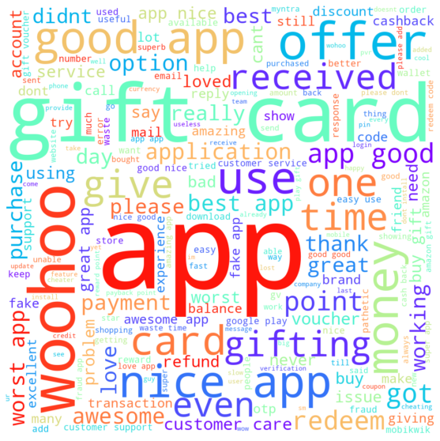
Word cloud

Slide 17
Analysis

Slide 18
Woohoo Gift card- Self Evaluate
Self Evaluate | 2015 | 2016 | 2017 | 2018 | 2019 | 2020 | 2021 | Total
Negative | 442 | 94 | 94 | 127 | 95 | 164 | 133 | 1149
Positive | 550 | 127 | 60 | 101 | 91 | 378 | 326 | 1633
Grand Total | 992 | 221 | 154 | 228 | 186 | 542 | 459 | 2782
Self Evaluate % | 2015 | 2016 | 2017 | 2018 | 2019 | 2020 | 2021 | Total
Negative | 45% | 43% | 61% | 56% | 51% | 30% | 29% | 41%
Positive | 55% | 57% | 39% | 44% | 49% | 70% | 71% | 59%
Total Reviewers % | 36% | 8% | 6% | 8% | 7% | 19% | 16% | 100
In the Year 2021 the company has the highest Positive Rating compared to previous year . But when we aggregate it has only 16% Reviewers of the total 7 years data.
In the self evaluate overall we have 59% positive and 41% Negative

Slide 19
Woohoo Gift card- NRC Sentiment
Year | positive | negative | anger | anticipation | disgust | fear | joy | sadness | surprise | trust
2015 | 641 | 362 | 175 | 502 | 151 | 144 | 444 | 184 | 344 | 495
2016 | 149 | 62 | 43 | 109 | 31 | 31 | 110 | 36 | 96 | 101
2017 | 96 | 68 | 45 | 73 | 28 | 23 | 75 | 28 | 66 | 80
2018 | 144 | 85 | 50 | 126 | 32 | 38 | 113 | 45 | 99 | 100
2019 | 131 | 60 | 32 | 106 | 31 | 30 | 100 | 39 | 88 | 83
2020 | 374 | 123 | 67 | 298 | 51 | 53 | 317 | 68 | 268 | 281
2021 | 291 | 107 | 65 | 237 | 33 | 60 | 241 | 55 | 201 | 197
Total | 1826 | 867 | 477 | 1451 | 357 | 379 | 1400 | 455 | 1162 | 1337
The National Research Council Canada's (NRC) Emotion Lexicon
Year | positive | negative | anger | anticipation | disgust | fear | joy | sadness | surprise | trust
2015 | 65% | 36% | 18% | 51% | 15% | 15% | 45% | 19% | 35% | 50%
2016 | 67% | 28% | 19% | 49% | 14% | 14% | 50% | 16% | 43% | 46%
2017 | 62% | 44% | 29% | 47% | 18% | 15% | 49% | 18% | 43% | 52%
2018 | 63% | 37% | 22% | 55% | 14% | 17% | 50% | 20% | 43% | 44%
2019 | 70% | 32% | 17% | 57% | 17% | 16% | 54% | 21% | 47% | 45%
2020 | 69% | 23% | 12% | 55% | 9% | 10% | 58% | 13% | 49% | 52%
2021 | 63% | 23% | 14% | 52% | 7% | 13% | 53% | 12% | 44% | 43%
Total | 66% | 31% | 17% | 52% | 13% | 14% | 50% | 16% | 42% | 48%
In the Year 2020 and 2021 the company has the reduced the Negative Rating to 23% compared to previous year .
Anticipation , joy, Surprise trust have got the highest rating of 42-52%, were as the anger , disgust and sadness is 14- 17% which we need to addressed by the company.
In the NRC overall we have 66% positive and 31% Negative

Slide 20
Woohoo Gift card- Vader Sentiment
Valence Aware Dictionary and sentiment Reasoner) Emotion Lexicon
V sentiment # | 2015 | 2016 | 2017 | 2018 | 2019 | 2020 | 2021 | Total
Negative | 226 | 38 | 40 | 60 | 51 | 76 | 56 | 547
Positive | 766 | 183 | 114 | 168 | 135 | 466 | 403 | 2235
Grand Total | 992 | 221 | 154 | 228 | 186 | 542 | 459 | 2782
Vsentiment % | 2015 | 2016 | 2017 | 2018 | 2019 | 2020 | 2021 | Total
Negative | 23% | 17% | 26% | 26% | 27% | 14% | 12% | 20%
Positive | 77% | 83% | 74% | 74% | 73% | 86% | 88% | 80%
Total Reviewers % | 36% | 8% | 6% | 8% | 7% | 19% | 16% | 100
Negative reviews has been reducing to 12% and Positive reviews is increasing to 88% over the past years. Year on year we can observe the customer having positive opinion about the product / service.
In the Vader S overall we have 80% positive and 20% Negative

Slide 21
Self evaluate – NRC – Vader Sentiment
 | Self Evaluate |  | NRC Sentiment |  | Vader Sentiment
Sentiment # | Negative | Positive | Negative | Positive | Negative | Positive | Total
2015 | 442 | 550 | 362 | 641 | 226 | 766 | 992
2016 | 94 | 127 | 62 | 149 | 38 | 183 | 221
2017 | 94 | 60 | 68 | 96 | 40 | 114 | 154
2018 | 127 | 101 | 85 | 144 | 60 | 168 | 228
2019 | 95 | 91 | 60 | 131 | 51 | 135 | 186
2020 | 164 | 378 | 123 | 374 | 76 | 466 | 542
2021 | 133 | 326 | 107 | 291 | 56 | 403 | 459
Total | 1149 | 1633 | 867 | 1826 | 547 | 2235 | 2782
Sentiment % | Negative | Positive | Negative | Positive | Negative | Positive | Total
2015 | 45% | 55% | 36% | 65% | 23% | 77% | 992
2016 | 43% | 57% | 28% | 67% | 17% | 83% | 221
2017 | 61% | 39% | 44% | 62% | 26% | 74% | 154
2018 | 56% | 44% | 37% | 63% | 26% | 74% | 228
2019 | 51% | 49% | 32% | 70% | 27% | 73% | 186
2020 | 30% | 70% | 23% | 69% | 14% | 86% | 542
2021 | 29% | 71% | 23% | 63% | 12% | 88% | 459
Total | 41% | 59% | 31% | 66% | 20% | 80% | 2782
When we compare the 3 sentiments- NRC 66% and Vader Sentiment 80% is giving higher Positive scores compared to self evaluate .

Slide 22
Cross Tab. Self evaluate with NRC
In the NRC Sentiment , we are rating both the Positive and negative sentiment and tracking separately.
Negative Self evaluate was 41 % , and the NRC was able to find Better Negative reviews with 63 % . But overall the reviews had both negative and positive reviews more than 63%.
This means customers who have negative opinion, also have given positive reviews .
Positive Self evaluate was 59 % , and the NRC was able to find Better Positive reviews with 65 % difference of 6%. Among the 59 % positive NRC was able to find 9 % negative sentiment . Area for improvement for the company.
Sentiment | NRC Sentiment
Self Evaluate | positive | negative | Total
Negative | 771 | 721 | 1149
Positive | 1055 | 146 | 1633
Total | 1826 | 867 | 2782
Sentiment | NRC Sentiment
Self Evaluate | Positive | Negative | Total
Negative | 67% | 63% | 41%
Positive | 65% | 9% | 59%
Total | 66% | 31%
Row Labels | No Positive & Negative | Both Positive and negative | Only Negative | Only Positive | Total
Negative | 148 | 491 | 230 | 280 | 1149
Positive | 550 | 118 | 28 | 937 | 1633
Grand Total | 698 | 609 | 258 | 1217 | 2782
The second table shows that if there is any overlap between the sentiments and no sentiment.
Of the 59 % positive sentiment , NRC Was able to find only Positive sentiment of 57 % and 34 % of the records where not having any positive or negative sentiments.
On the other hand 41 % of negative 43 % of the respondent reviews has both positive and negatively coded.
NRC Sentiment is able to predict better to our self evaluate sentiment.
NRC – Sentiment Break up | No Positive & Negative | Both Positive and negative | Only Negative | Only Positive | Total
Negative | 13% | 43% | 20% | 24% | 41%
Positive | 34% | 7% | 2% | 57% | 59%
Total | 25% | 22% | 9% | 44%

Slide 23
Cross Tab. Self evaluate with Vader Sentiment
As in the Vader Sentiment , From the compounding scores (Neg, Neu , Pos) , we have rated > 0 as positive and <0 as negative .
Negative Self evaluate was 41 % , and the Vader S was able to find around 47% only Negative reviews and 53 % marked as positive.
Vader S is able to identify 47 % Negative scores,
Positive Self evaluate was 59 % , and the Vader S was able to find Better more accurately Positive reviews with 99 % accuracy. Among the 59 % positive NRC was able to find 1 % negative sentiment .
Sentiment | Vader Sentiment
Self Evaluate | Positive | Negative | Total
Negative | 614 | 535 | 1149
Positive | 1621 | 12 | 1633
Grand Total | 2235 | 547 | 2782
Sentiment | Vader Sentiment
Self Evaluate | Positive | Negative | Total
Negative | 53% | 47% | 41%
Positive | 99% | 1% | 59%
Grand Total | 80% | 20%

Slide 24
Conclusion on Lexicon Sentiment
Post comparing the NRC and Vader sentiment analysis, we observed that we get better results in Vader Lexicon sentiment 99% Positive Reviews mapped correctly. When compared with NRC it was only 65 %.
In the next step we will validate from the Naive Bayesian model Count vectorizer and TFIDF vectorizer models does the Sentiments coded by lexicon is giving good results in predicting the outcome.

Slide 25
Naive Bayesian - Bag of Words (BoW) using Count Vectorizer
A bag-of-words model, or BoW for short, is a way of extracting features from text for use in modelling.
Count Vectorizer It is used to transform a given text into a vector on the basis of the frequency (count) of each word that occurs in the entire text.
 | precision | recall | f1-score | support
Negative | 63% | 84% | 72% | 152
Positive | 96% | 89% | 92% | 683
accuracy |  |  | 88% | 835
Using the Vader Lexicon sentiment we are looking at the Naive Bayesian - Bag of Words (BoW) using Count Vectorizer, , In order to efficiently predict the sentiment using the 70 Train and 30 test split and evaluating the accuracy of the model.
For the Train data set model accuracy we got 88%.
For the test data set also we got 88% accuracy,
Positive Sentiment Precision of 96% , Recall of 89 % and F1 score 92% for the.
Negative sentiment the precision was only 63% ,recall 84% and F1 score 72 %.
We need to have better Negative Sentiment Precision.

Slide 26
Naive Bayesian - Bag of Words (BoW) using TF-IDF Vectorizer
A bag-of-words model, or BoW for short, is a way of extracting features from text for use in modelling.
TF-IDF is a statistical measure that evaluates how relevant a word is to a document in a collection of documents. This is done by multiplying two metrics: how many times a word appears in a document, and the inverse document frequency of the word across a set of documents.
 | precision | recall | f1-score | support
Negative | 72% | 68% | 70% | 152
Positive | 93% | 94% | 93% | 683
accuracy |  |  | 89% | 835
Using the Vader Lexicon sentiment we are using at the Naive Bayesian - Bag of Words (BoW) using TF-IDF Vectorizer, In order to efficiently predict the sentiment using the 70 Train and 30 test split and evaluating the accuracy of the model.
For the Train data set model accuracy we got 89%.
For the test data set also we got 89% accuracy,
Positive Sentiment Precision of 93% , Recall of 94 % and F1 score 93% for the.
Negative sentiment the precision was only 72% ,recall 68%% and F1 score 70 %.
Conclusion :- TFIDF Model is able to predict the Positive and negative sentiment better than count vectorizer Model as there is increase in model accuracy by 1 % and Negative sentiment Precision has increased by 9% .

Slide 27
Analyzing Complaints and Praises
Category | Reviews | Reviews %
Negative only | 273 | 10%
Complaints | 274 | 10%
Positive Only | 1895 | 68%
Praise | 340 | 12%
Total | 2782 | 100%
From The 547 negative reviews Identified by Vader lexicon sentiment , we have segregated into 4 categories Complaints, Negative only , Positive only and Praise.
1) “Complaints” with 10 % is having Negative High score followed by mix of Positive scores & Neutral scores.
2) “Negative only” with 10 % is having only Negative score and neutral scores.
3) “Positive only” 68 % is having Positive High score followed by mix of Negative scores & Neutral scores.
4) “Praise” 12% is having only Positive score and neutral scores.
Category | 2015 | 2016 | 2017 | 2018 | 2019 | 2020 | 2021
Negative only | 12% | 10% | 15% | 12% | 13% | 6% | 5%
Complaint | 11% | 7% | 11% | 14% | 14% | 8% | 7%
Positive Only | 65% | 70% | 57% | 57% | 61% | 78% | 74%
Praise | 12% | 13% | 17% | 17% | 11% | 8% | 14%
Conclusion :
Overall : -Majority of the reviews are towards “Positive only” which is good, but the company has to work towards converting the Praise 12% to “positive only” , followed by the negative reviews 20%.
2021 :- Over the past 6 years the company has been able to improve the scores for “Positive only” for 2021 with 74% , and improved the praise to 14% and reduced the negative reviews.

Slide 28
Analyzing Complaints and Praises- Words and Length
On an average number of words 14.67 Words are used in reviews and 79.29 Avg Length of the reviews.
For Praise has the highest average for both Avg # of words 32 and Avg. length 174.
For the Positive only has the Lowest average for both Avg # of words 9 and Avg. length 52.
Category | Avg. # of words | Avg. length
Negative only | 11.84 | 63.52
Complaint | 28.92 | 160.72
Positive Only | 9.85 | 52.71
Praise | 32.32 | 174.45
Grand Total | 14.67 | 79.29
Avg. # of words | Column Labels
Category | 2015 | 2016 | 2017 | 2018 | 2019 | 2020 | 2021
Negative only | 14.1 | 12.3 | 7.7 | 9.7 | 9.4 | 9.1 | 12.6
Complaint | 29.8 | 28.5 | 24.9 | 25.9 | 26.2 | 29.5 | 32.9
Positive Only | 10.5 | 11.2 | 10.2 | 7.9 | 7.2 | 9.6 | 9.8
Praise | 32.7 | 37.5 | 39.8 | 35.2 | 28.1 | 31.0 | 26.8
Grand Total | 15.7 | 15.9 | 16.4 | 15.2 | 12.5 | 13.0 | 13.9
Avg. length
Category | 2015 | 2016 | 2017 | 2018 | 2019 | 2020 | 2021
Negative only | 75.9 | 64.4 | 39.4 | 54.7 | 50.6 | 49.2 | 66.2
Complaint | 163.9 | 158.6 | 136.5 | 142.7 | 143.9 | 167.5 | 186.3
Positive Only | 56.7 | 60.1 | 54.2 | 42.5 | 38.5 | 51.5 | 51.5
Praise | 177.9 | 200.3 | 215.6 | 187.4 | 151.8 | 171.6 | 140.6
Grand Total | 85.0 | 85.4 | 88.3 | 82.6 | 67.7 | 70.8 | 74.0
Conclusion :
Customers tend to write less when they are either very happy(Positive only) or very unsatisfied(Negative only)
On an average the reviews Avg # word and Avg length has reduced from 15.7 to 13.9 and 85 to 74.
Avg # word :-
Over the past 6 years the customers are writing very less words to express their feeling having “Positive only” (2021 : 9.8) and Praise (2021: 13.9). But for “Negative only” and Complaining the Avg # words have increased.
Avg Length :- Complaint Length is increasing over the past years , for 2021 with 186.3 was the highest.

Slide 29
Product features by category.
Overall 31 % of the customers feel the App/web good , 23 % of the Customers feel that there are issues in the App/ Web which needs to be fixed. 3rd highest is Not trusting the Brand having 18 %.
Under the category wise positive only stands significantly high with 28% customers feeling the app / web application is good.
Promotion/offers good, Easy to use , Access to Multiple Brands to choose for purchase, and delivery of service Good are the other key features customers lookout for while purchasing gift card. In order to increase the Positive only and praise
Delivery of service not good, Customer Support not good, App/ Web Issues, Not Trusting the Brand are the Key product features due to which the customers having given complaints and Negative only reviews.
Product features | Complaint | Negative only | Positive Only | Praise | Total
Customer Support not good | 3% | 1% | 1% | 3% | 8%
Delivery of service not good | 5% | 2% | 4% | 4% | 16%
App/ Web Issues | 5% | 5% | 7% | 5% | 23%
Payment Issues | 1% | 1% | 2% | 2% | 6%
Promotion/offers Issues | 2% | 1% | 3% | 2% | 9%
Validity Issues | 0% | 0% | 0% | 0% | 1%
Not Trusting the Brand | 7% | 5% | 2% | 4% | 18%
Speed of delivery good | 0% | 0% | 2% | 0% | 2%
App/ Web good | 0% | 0% | 28% | 3% | 31%
Promotion/offers good | 0% | 0% | 6% | 1% | 7%
Price is good | 0% | 0% | 0% | 0% | 0%
Customer Support good | 0% | 0% | 1% | 0% | 1%
Easy to use | 0% | 0% | 6% | 1% | 6%
Multiple Brands to choose good | 0% | 0% | 3% | 0% | 4%
Delivery of service good | 0% | 0% | 3% | 1% | 4%
Payment Good | 0% | 0% | 1% | 0% | 1%

Slide 30
Analysis by Comparing the Product performance with Categories and also compare over the past performance..
Category | Complaint
Year | 2015 | 2016 | 2017 | 2018 | 2019 | 2020 | 2021 | Total
Customer Support not good | 1.9% | 1.8% | 3.2% | 3.5% | 5.4% | 4.2% | 4.8% | 3%
Delivery of service not good | 4.1% | 3.2% | 5.8% | 7.0% | 7.5% | 4.6% | 4.1% | 5%
App/ Web Issues | 7.4% | 5.0% | 6.5% | 7.9% | 8.1% | 3.0% | 2.0% | 5%
Payment Issues | 0.7% | 0.5% | 3.2% | 2.6% | 2.2% | 1.8% | 2.0% | 1%
Promotion/offers Issues | 3.9% | 1.8% | 0.6% | 2.2% | 2.2% | 0.9% | 0.9% | 2%
Validity Issues | 0.2% | 0.0% | 0.0% | 0.0% | 0.5% | 0.0% | 0.2% | 0%
Not Trusting the Brand | 6.8% | 5.4% | 10.4% | 10.5% | 11.3% | 5.7% | 4.8% | 7%
Speed of delivery good | 0.0% | 0.0% | 0.0% | 0.0% | 0.0% | 0.2% | 0.0% | 0%
App/ Web good | 0.3% | 0.0% | 0.0% | 0.0% | 0.0% | 0.0% | 0.0% | 0%
Promotion/offers good | 0.0% | 0.0% | 0.0% | 0.0% | 0.0% | 0.0% | 0.0% | 0%
Price is good | 0.0% | 0.0% | 0.0% | 0.0% | 0.0% | 0.0% | 0.0% | 0%
Customer Support good | 0.2% | 0.0% | 0.0% | 0.0% | 0.0% | 0.0% | 0.0% | 0%
Easy to use | 0.1% | 0.0% | 0.0% | 0.0% | 0.0% | 0.0% | 0.0% | 0%
Multiple Brands to choose good | 0.1% | 0.0% | 0.0% | 0.0% | 0.0% | 0.0% | 0.0% | 0%
Delivery of service good | 0% | 0% | 0% | 0% | 0% | 0% | 0% | 0%
Payment Good | 0% | 0% | 0% | 0% | 0% | 0% | 0% | 0%
Feature Services Not performing well and deteriorating
Feature Services performance has been improved.
Feature Services performance has to been reduced, if it is improved will have a positive effect.
Feature Services has performed well and increasing

Slide 31
Analysis by Comparing the Product performance with Categories and also compare over the past performance..
Category | Negative only
Year | 2015 | 2016 | 2017 | 2018 | 2019 | 2020 | 2021 | Total
Customer Support not good | 0.4% | 0.9% | 1.9% | 2.2% | 1.1% | 0.7% | 0.4% | 1%
Delivery of service not good | 3.0% | 2.3% | 3.9% | 3.1% | 1.6% | 1.7% | 2.4% | 2%
App/ Web Issues | 7.7% | 5.4% | 7.1% | 5.3% | 9.7% | 2.2% | 1.7% | 5%
Payment Issues | 0.7% | 0.9% | 1.9% | 1.8% | 0.0% | 0.7% | 0.4% | 1%
Promotion/offers Issues | 2.5% | 0.9% | 1.3% | 0.9% | 1.6% | 0.7% | 0.2% | 1%
Validity Issues | 0.0% | 0.0% | 0.0% | 0.0% | 0.0% | 0.0% | 0.0% | 0%
Not Trusting the Brand | 6.9% | 4.1% | 7.8% | 7.0% | 4.3% | 3.0% | 3.3% | 5%
Speed of delivery good | 0.0% | 0.0% | 0.0% | 0.0% | 0.0% | 0.0% | 0.0% | 0%
App/ Web good | 0.1% | 0.0% | 0.0% | 0.0% | 0.0% | 0.0% | 0.0% | 0%
Promotion/offers good | 0.0% | 0.0% | 0.0% | 0.0% | 0.0% | 0.0% | 0.0% | 0%
Price is good | 0.0% | 0.0% | 0.0% | 0.0% | 0.0% | 0.0% | 0.0% | 0%
Customer Support good | 0.0% | 0.0% | 0.0% | 0.0% | 0.0% | 0.0% | 0.0% | 0%
Easy to use | 0.0% | 0.0% | 0.0% | 0.0% | 0.0% | 0.0% | 0.0% | 0%
Multiple Brands to choose good | 0.0% | 0.0% | 0.0% | 0.0% | 0.0% | 0.0% | 0.0% | 0%
Delivery of service good | 0% | 0% | 0% | 0% | 0% | 0% | 0% | 0%
Payment Good | 0% | 0% | 0% | 0% | 0% | 0% | 0% | 0%
Feature Services Not performing well and deteriorating
Feature Services performance has been improved.
Feature Services performance has to been reduced, if it is improved will have a positive effect.
Feature Services has performed well and increasing

Slide 32
Analysis by Comparing the Product performance with Categories and also compare over the past performance..
Category | Positive Only
Year | 2015 | 2016 | 2017 | 2018 | 2019 | 2020 | 2021 | Total
Customer Support not good | 0.6% | 0.5% | 3.9% | 0.9% | 2.7% | 1.3% | 1.5% | 1%
Delivery of service not good | 3.6% | 3.2% | 6.5% | 6.6% | 4.8% | 3.3% | 6.5% | 4%
App/ Web Issues | 9.5% | 6.8% | 7.8% | 8.8% | 10.8% | 5.9% | 4.8% | 7%
Payment Issues | 1.8% | 3.2% | 5.8% | 3.9% | 1.6% | 1.7% | 2.2% | 2%
Promotion/offers Issues | 4.0% | 5.9% | 2.6% | 3.5% | 0.5% | 1.7% | 2.0% | 3%
Validity Issues | 0.4% | 0.0% | 0.0% | 0.0% | 0.0% | 0.2% | 0.0% | 0%
Not Trusting the Brand | 2.2% | 1.4% | 4.5% | 2.2% | 1.1% | 0.2% | 1.1% | 2%
Speed of delivery good | 0.8% | 3.2% | 2.6% | 0.4% | 0.5% | 1.5% | 6.5% | 2%
App/ Web good | 23.7% | 27.1% | 11.0% | 16.7% | 15.6% | 44.3% | 43.4% | 28%
Promotion/offers good | 9.4% | 9.5% | 2.6% | 3.1% | 1.1% | 6.1% | 4.1% | 6%
Price is good | 0.4% | 0.0% | 0.0% | 0.0% | 0.0% | 0.6% | 0.2% | 0%
Customer Support good | 0.5% | 0.9% | 0.6% | 0.0% | 1.6% | 0.2% | 0.9% | 1%
Easy to use | 4.4% | 9.0% | 1.9% | 2.2% | 2.7% | 12.4% | 3.7% | 6%
Multiple Brands to choose good | 2.9% | 2.7% | 1.3% | 1.3% | 1.1% | 8.1% | 2.8% | 3%
Delivery of service good | 1.8% | 2.3% | 1.9% | 1.8% | 2.2% | 3.0% | 8.3% | 3%
Payment Good | 1.0% | 0.5% | 0.0% | 0.0% | 0.0% | 0.7% | 1.3% | 1%
Feature Services Not performing well and deteriorating
Feature Services performance has been improved.
Feature Services performance has been reduced, if it is improved will have a positive effect.
Feature Services has performed well and increasing

Slide 33
Analysis by Comparing the Product performance with Categories and also compare over the past performance..
Category |  | Praise
Year |  | 2015 | 2016 | 2017 | 2018 | 2019 | 2020 | 2021 | Total
Customer Support not good |  | 2.0% | 4.1% | 3.9% | 3.5% | 3.2% | 2.2% | 3.7% | 3%
Delivery of service not good |  | 4.0% | 4.5% | 9.1% | 6.6% | 4.3% | 3.0% | 4.6% | 4%
App/ Web Issues |  | 7.1% | 5.9% | 9.7% | 8.8% | 5.4% | 2.6% | 2.4% | 5%
Payment Issues |  | 0.8% | 0.5% | 7.1% | 3.9% | 1.1% | 0.7% | 2.2% | 2%
Promotion/offers Issues |  | 3.6% | 3.2% | 1.3% | 3.1% | 1.6% | 0.9% | 0.4% | 2%
Validity Issues |  | 0.6% | 0.9% | 0.6% | 0.0% | 1.1% | 0.0% | 0.0% | 0%
Not Trusting the Brand |  | 4.3% | 5.9% | 9.1% | 9.6% | 4.3% | 2.0% | 3.3% | 4%
Speed of delivery good |  | 0.0% | 0.0% | 0.0% | 0.0% | 0.0% | 0.2% | 0.7% | 0%
App/ Web good |  | 2.5% | 2.3% | 2.6% | 1.8% | 1.1% | 1.8% | 6.5% | 3%
Promotion/offers good |  | 1.5% | 0.0% | 0.0% | 0.0% | 0.0% | 0.7% | 1.7% | 1%
Price is good |  | 0.1% | 0.0% | 0.0% | 0.0% | 0.0% | 0.0% | 0.4% | 0%
Customer Support good |  | 0.6% | 0.0% | 1.3% | 0.4% | 0.0% | 0.0% | 0.4% | 0%
Easy to use |  | 0.2% | 0.9% | 1.3% | 1.3% | 0.5% | 0.4% | 0.7% | 1%
Multiple Brands to choose good |  | 0.4% | 0.0% | 0.0% | 0.9% | 0.0% | 0.4% | 0.4% | 0%
Delivery of service good |  | 0.3% | 0.5% | 1.3% | 0.0% | 0.5% | 0.4% | 1.5% | 1%
Payment Good |  | 0.1% | 0.0% | 0.0% | 0.0% | 0.0% | 0.2% | 0.2% | 0%
Feature Services Not performing well and deteriorating
Feature Services performance has been improved.
Feature Services performance has to been reduced, if it is improved will have a positive effect.
Feature Services has performed well and increasing

Slide 34
Analysis by Comparing the Product performance with Categories and also compare over the past performance..
Category | Complaint |  |  |  |  |  |  |  |  | Negative only
Year | 2015 | 2016 | 2017 | 2018 | 2019 | 2020 | 2021 | Total |  | 2015 | 2016 | 2017 | 2018 | 2019 | 2020 | 2021 | Total
Customer Support not good | 1.9% | 1.8% | 3.2% | 3.5% | 5.4% | 4.2% | 4.8% | 3% |  | 0.4% | 0.9% | 1.9% | 2.2% | 1.1% | 0.7% | 0.4% | 1%
Delivery of service not good | 4.1% | 3.2% | 5.8% | 7.0% | 7.5% | 4.6% | 4.1% | 5% |  | 3.0% | 2.3% | 3.9% | 3.1% | 1.6% | 1.7% | 2.4% | 2%
App/ Web Issues | 7.4% | 5.0% | 6.5% | 7.9% | 8.1% | 3.0% | 2.0% | 5% |  | 7.7% | 5.4% | 7.1% | 5.3% | 9.7% | 2.2% | 1.7% | 5%
Payment Issues | 0.7% | 0.5% | 3.2% | 2.6% | 2.2% | 1.8% | 2.0% | 1% |  | 0.7% | 0.9% | 1.9% | 1.8% | 0.0% | 0.7% | 0.4% | 1%
Promotion/offers Issues | 3.9% | 1.8% | 0.6% | 2.2% | 2.2% | 0.9% | 0.9% | 2% |  | 2.5% | 0.9% | 1.3% | 0.9% | 1.6% | 0.7% | 0.2% | 1%
Validity Issues | 0.2% | 0.0% | 0.0% | 0.0% | 0.5% | 0.0% | 0.2% | 0% |  | 0.0% | 0.0% | 0.0% | 0.0% | 0.0% | 0.0% | 0.0% | 0%
Not Trusting the Brand | 6.8% | 5.4% | 10.4% | 10.5% | 11.3% | 5.7% | 4.8% | 7% |  | 6.9% | 4.1% | 7.8% | 7.0% | 4.3% | 3.0% | 3.3% | 5%
Speed of delivery good | 0.0% | 0.0% | 0.0% | 0.0% | 0.0% | 0.2% | 0.0% | 0% |  | 0.0% | 0.0% | 0.0% | 0.0% | 0.0% | 0.0% | 0.0% | 0%
App/ Web good | 0.3% | 0.0% | 0.0% | 0.0% | 0.0% | 0.0% | 0.0% | 0% |  | 0.1% | 0.0% | 0.0% | 0.0% | 0.0% | 0.0% | 0.0% | 0%
Promotion/offers good | 0.0% | 0.0% | 0.0% | 0.0% | 0.0% | 0.0% | 0.0% | 0% |  | 0.0% | 0.0% | 0.0% | 0.0% | 0.0% | 0.0% | 0.0% | 0%
Price is good | 0.0% | 0.0% | 0.0% | 0.0% | 0.0% | 0.0% | 0.0% | 0% |  | 0.0% | 0.0% | 0.0% | 0.0% | 0.0% | 0.0% | 0.0% | 0%
Customer Support good | 0.2% | 0.0% | 0.0% | 0.0% | 0.0% | 0.0% | 0.0% | 0% |  | 0.0% | 0.0% | 0.0% | 0.0% | 0.0% | 0.0% | 0.0% | 0%
Easy to use | 0.1% | 0.0% | 0.0% | 0.0% | 0.0% | 0.0% | 0.0% | 0% |  | 0.0% | 0.0% | 0.0% | 0.0% | 0.0% | 0.0% | 0.0% | 0%
Multiple Brands to choose good | 0.1% | 0.0% | 0.0% | 0.0% | 0.0% | 0.0% | 0.0% | 0% |  | 0.0% | 0.0% | 0.0% | 0.0% | 0.0% | 0.0% | 0.0% | 0%
Delivery of service good | 0% | 0% | 0% | 0% | 0% | 0% | 0% | 0% |  | 0% | 0% | 0% | 0% | 0% | 0% | 0% | 0%
Payment Good | 0% | 0% | 0% | 0% | 0% | 0% | 0% | 0% |  | 0% | 0% | 0% | 0% | 0% | 0% | 0% | 0%
 | Positive Only |  |  |  |  |  |  |  |  | Praise
Customer Support not good | 0.6% | 0.5% | 3.9% | 0.9% | 2.7% | 1.3% | 1.5% | 1% |  | 2.0% | 4.1% | 3.9% | 3.5% | 3.2% | 2.2% | 3.7% | 3%
Delivery of service not good | 3.6% | 3.2% | 6.5% | 6.6% | 4.8% | 3.3% | 6.5% | 4% |  | 4.0% | 4.5% | 9.1% | 6.6% | 4.3% | 3.0% | 4.6% | 4%
App/ Web Issues | 9.5% | 6.8% | 7.8% | 8.8% | 10.8% | 5.9% | 4.8% | 7% |  | 7.1% | 5.9% | 9.7% | 8.8% | 5.4% | 2.6% | 2.4% | 5%
Payment Issues | 1.8% | 3.2% | 5.8% | 3.9% | 1.6% | 1.7% | 2.2% | 2% |  | 0.8% | 0.5% | 7.1% | 3.9% | 1.1% | 0.7% | 2.2% | 2%
Promotion/offers Issues | 4.0% | 5.9% | 2.6% | 3.5% | 0.5% | 1.7% | 2.0% | 3% |  | 3.6% | 3.2% | 1.3% | 3.1% | 1.6% | 0.9% | 0.4% | 2%
Validity Issues | 0.4% | 0.0% | 0.0% | 0.0% | 0.0% | 0.2% | 0.0% | 0% |  | 0.6% | 0.9% | 0.6% | 0.0% | 1.1% | 0.0% | 0.0% | 0%
Not Trusting the Brand | 2.2% | 1.4% | 4.5% | 2.2% | 1.1% | 0.2% | 1.1% | 2% |  | 4.3% | 5.9% | 9.1% | 9.6% | 4.3% | 2.0% | 3.3% | 4%
Speed of delivery good | 0.8% | 3.2% | 2.6% | 0.4% | 0.5% | 1.5% | 6.5% | 2% |  | 0.0% | 0.0% | 0.0% | 0.0% | 0.0% | 0.2% | 0.7% | 0%
App/ Web good | 23.7% | 27.1% | 11.0% | 16.7% | 15.6% | 44.3% | 43.4% | 28% |  | 2.5% | 2.3% | 2.6% | 1.8% | 1.1% | 1.8% | 6.5% | 3%
Promotion/offers good | 9.4% | 9.5% | 2.6% | 3.1% | 1.1% | 6.1% | 4.1% | 6% |  | 1.5% | 0.0% | 0.0% | 0.0% | 0.0% | 0.7% | 1.7% | 1%
Price is good | 0.4% | 0.0% | 0.0% | 0.0% | 0.0% | 0.6% | 0.2% | 0% |  | 0.1% | 0.0% | 0.0% | 0.0% | 0.0% | 0.0% | 0.4% | 0%
Customer Support good | 0.5% | 0.9% | 0.6% | 0.0% | 1.6% | 0.2% | 0.9% | 1% |  | 0.6% | 0.0% | 1.3% | 0.4% | 0.0% | 0.0% | 0.4% | 0%
Easy to use | 4.4% | 9.0% | 1.9% | 2.2% | 2.7% | 12.4% | 3.7% | 6% |  | 0.2% | 0.9% | 1.3% | 1.3% | 0.5% | 0.4% | 0.7% | 1%
Multiple Brands to choose good | 2.9% | 2.7% | 1.3% | 1.3% | 1.1% | 8.1% | 2.8% | 3% |  | 0.4% | 0.0% | 0.0% | 0.9% | 0.0% | 0.4% | 0.4% | 0%
Delivery of service good | 1.8% | 2.3% | 1.9% | 1.8% | 2.2% | 3.0% | 8.3% | 3% |  | 0.3% | 0.5% | 1.3% | 0.0% | 0.5% | 0.4% | 1.5% | 1%
Payment Good | 1.0% | 0.5% | 0.0% | 0.0% | 0.0% | 0.7% | 1.3% | 1% |  | 0.1% | 0.0% | 0.0% | 0.0% | 0.0% | 0.2% | 0.2% | 0%
Feature Services Not performing well and deteriorating
Feature Services performance has been improved.
Feature Services performance has to been reduced, if it is improved will have a positive effect.
Feature Services has performed well and increasing

Slide 35
SWOT Analysis

Slide 36
Recommendation

Slide 37
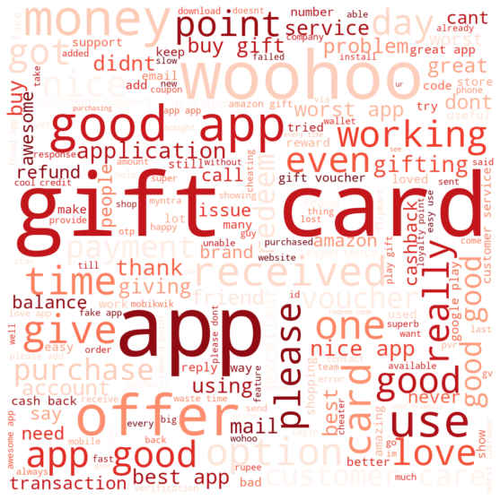
WORDCLOUD - NRC – EMOTION - Positive

Slide 38
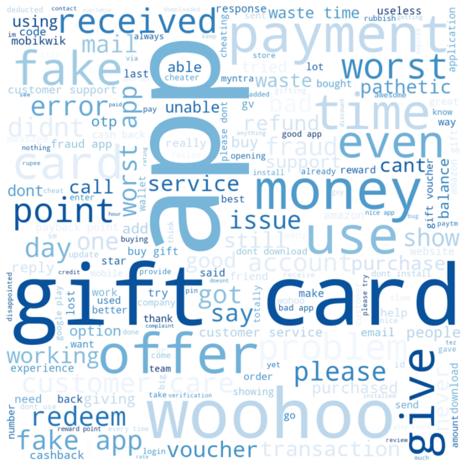
WORDCLOUD - NRC – EMOTION - Negative

Slide 39
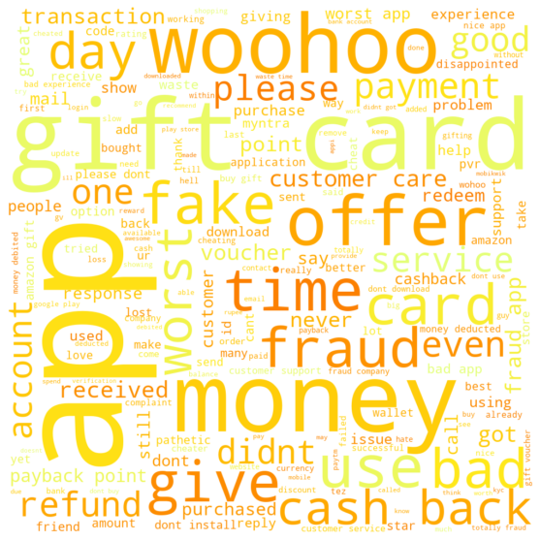
WORDCLOUD - NRC – EMOTION - Anger

Slide 40
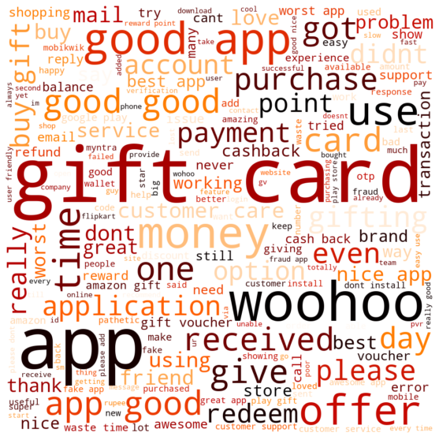
WORDCLOUD - NRC – EMOTION - Anticipation

Slide 41
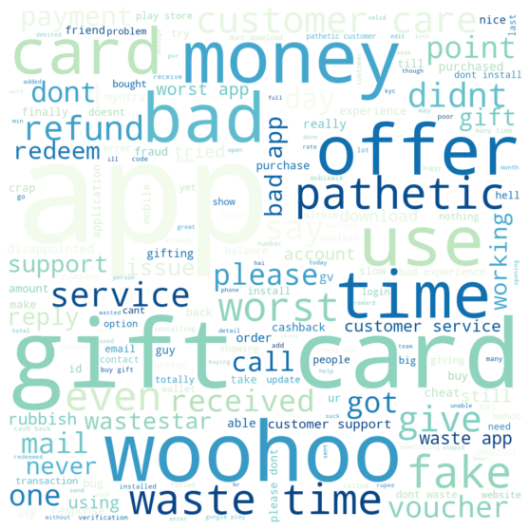
WORDCLOUD - NRC – EMOTION - Disgust

Slide 42
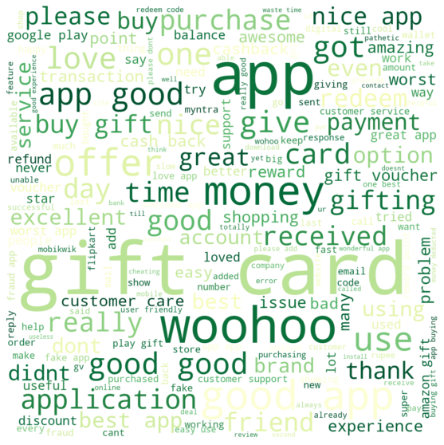
WORDCLOUD - NRC – EMOTION - Joy

Slide 43
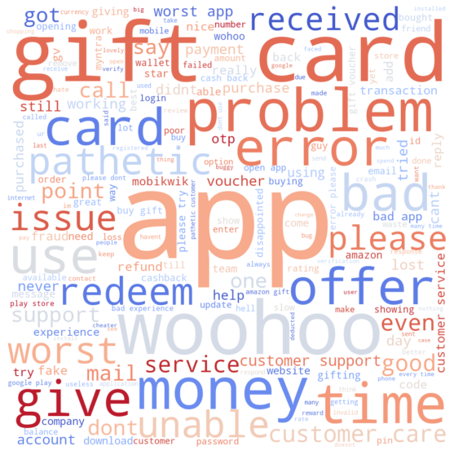
WORDCLOUD - NRC – EMOTION - Sadness

Slide 44

WORDCLOUD - NRC – EMOTION - Surprise

Slide 45
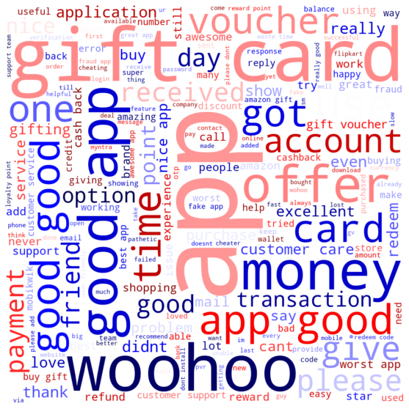
WORDCLOUD - NRC – EMOTION - Trust

Slide 46
References
Similar research articles/ papers published on the subject:
https://www.aclweb.org/anthology/W16-0418.pdf
https://www.alliedmarketresearch.com/gift-cards-market
https://www.businesswire.com/news/home/20200921005319/en/India-9.34-Billion-Gift-Card-and-Incentive-Card-Markets-2015-2019-2024-with-Covid-19-Update-Q2-2020---ResearchAndMarkets.com
https://www.qwikcilver.com/
https://www.woohoo.in/

Slide 47
Thank You

